Slide 1

JTI TME Project
New Joiner Introduction

Slide 2
Accenture Core Values
Accenture Core Values are defined in terms of
  One Global Network
  Best People
  Stewardship
  Integrity
  Respect for the individual
  Client Value Creation
  Additional information on Accenture Core Values can be obtained below:-
  https://publishing.accenture.com/CoreValues/default.htm

Slide 3
IT Support
Logging IT Support tickets
https://dcnitsupport.accenture.com/login.aspx?ReturnUrl=%2fDefault.aspx
Obtaining software
https://software.accenture.com/
Changing your Enterprise ID password
https://directory.accenture.com/

Slide 4
Human Resource
Updating your CV
https://myscheduling.accenture.com/
Performance Appraisal Process
https://myperformance.accenture.com/
HR portal & policies
https://ts2eme.accenture.com/sites/AFS/Mauritius/SolutionsEP/default.aspx
Leave Application
  To be planned in Holiday Planning Sheet
  To be formally approved by Team Lead and Project Manager before being submitted to HR
  https://ts2eme.accenture.com/sites/AFS/Mauritius/SolutionsEP/Shared%20Documents/Leave%20Policy_Accenture%20v%205%200_24_5_05%201.doc

Slide 5
ARTES Submission
Submitted twice per month before the 15th and end of each month
Installation of Artes is found at the following path
J:\0_NEW_STRUCTURE\1) General\0_APPLICATION_FILES\Artes France 2008 v8.0
Once installed, Artes need to be configured with Employee ID provided by HR
Charge Code to be used are as follows:-
  MIDC: BQ912004
  DCDMC: JT9C020
  Shadow resource MIDC: D1014021
  Shadow resource DCDMC: JT9N029

Slide 6

Project Charter
Defines the pillars of the project in terms of the defined MIDC charter in terms of
  Growth
  Agility
  Quality
  Winning Organization

Slide 7
Portal Web Site
Accenture Portal
https://portal.accenture.com
Project Portal
http://mr2ds0024/JTI/default.aspx

Slide 8
Emails & Communication
Personal Email (Web + Outlook Configured)
https://eme.mail.accenture.com/exchange/
Shared Mailbox – TME Helpdesk (Web + Outlook Configured)
https://eme.mail.accenture.com/exchange/TME_Helpdesk/
Outlook Configuration
  Open settings for current email account
  Click on More Settings
  Click on Advanced tab and add new mailbox TME_Helpdesk
Conference Call
Set up by accessing the web site https://gc27gw1.mymeetingplace.net/

Slide 9
Important CMMI documents
Project Management Plan
http://mr2ds0024/JTI/Shared%20Documents/[2]%20PP%20-%20Project%20Planning/01%20-%20PMP/JTI_Project_Management_Plan_V1.11.doc
Configuration Management Plan
http://mr2ds0024/JTI/Shared%20Documents/[2]%20PP%20-%20Project%20Planning/03%20-%20CMP/JTI_Configuration_Management_Plan_V1.4.doc
Quality Management Plan
http://mr2ds0024/JTI/Shared%20Documents/[2]%20PP%20-%20Project%20Planning/02%20-%20QMP/JTI_Quality_Management_Plan_V1.4.doc

Slide 10
Other Important CMMI documents
Minutes of Meeting – need to be completed for each meeting conducted on the project
http://mr2ds0024/JTI/Shared%20Documents/[2]%20PMC%20-%20Project%20Monitoring%20and%20Control/02%20-%20Minutes%20of%20Meeting/Template%20MOM/Minutes_Of_Meeting_DDMMYYYY.doc
Risk Management Process – track and mitigate risks on the project
http://mr2ds0024/JTI/Shared%20Documents/Forms/AllItems.aspx?RootFolder=%2fJTI%2fShared%20Documents%2f%5b3%5d%20RSKM%20%2d%20Risk%20Management&FolderCTID=&View=%7b59B097B0%2d8368%2d4A00%2dB31D%2dF80D42D4E1BB%7d
Decision Analysis Report – aid tool for any important decisions to be taken on the project
http://mr2ds0024/JTI/Shared%20Documents/Forms/AllItems.aspx?RootFolder=%2fJTI%2fShared%20Documents%2f%5b3%5d%20DAR%20%2d%20Decision%20Analysis%20and%20Resolution&FolderCTID=&View=%7b59B097B0%2d8368%2d4A00%2dB31D%2dF80D42D4E1BB%7d

Slide 11
Other Important CMMI documents
Requirements Traceability Matrix – tracks requirements in terms of their dependent objects
http://mr2ds0024/JTI/Shared%20Documents/Forms/AllItems.aspx?RootFolder=%2fJTI%2fShared%20Documents%2f%5b2%5d%20REQM%20%2d%20Requirements%20Management%2f02%20%2d%20Requirements%20Traceability%20Matrix&FolderCTID=&View=%7b59B097B0%2d8368%2d4A00%2dB31D%2dF80D42D4E1BB%7d
Status Report – to be completed on a weekly basis tracking down the actions completed during the past week
http://mr2ds0024/JTI/Shared%20Documents/Forms/AllItems.aspx?RootFolder=%2fJTI%2fShared%20Documents%2f%5b2%5d%20PMC%20%2d%20Project%20Monitoring%20and%20Control%2f01%20%2d%20Status%20Report&FolderCTID=&View=%7b59B097B0%2d8368%2d4A00%2dB31D%2dF80D42D4E1BB%7d
Issue Log – tracks all issues occurring on the project
http://mr2ds0024/JTI/Shared%20Documents/Forms/AllItems.aspx?RootFolder=%2fJTI%2fShared%20Documents%2f%5b2%5d%20PMC%20%2d%20Project%20Monitoring%20and%20Control%2f05%20%2d%20Issue%20Log&FolderCTID=&View=%7b59B097B0%2d8368%2d4A00%2dB31D%2dF80D42D4E1BB%7d

Slide 12
Other Important CMMI documents
PPDB – Process & Product Database – repository of assets that can be shared with other projects at the capability or centre level
http://mr2ds0024/JTI/Shared%20Documents/Forms/AllItems.aspx?RootFolder=%2fJTI%2fShared%20Documents%2f%5b3%5d%20IPM%20%2d%20Integrated%20Project%20Management%2f04%20%2d%20PPDB&FolderCTID=&View=%7b59B097B0%2d8368%2d4A00%2dB31D%2dF80D42D4E1BB%7d

Slide 13
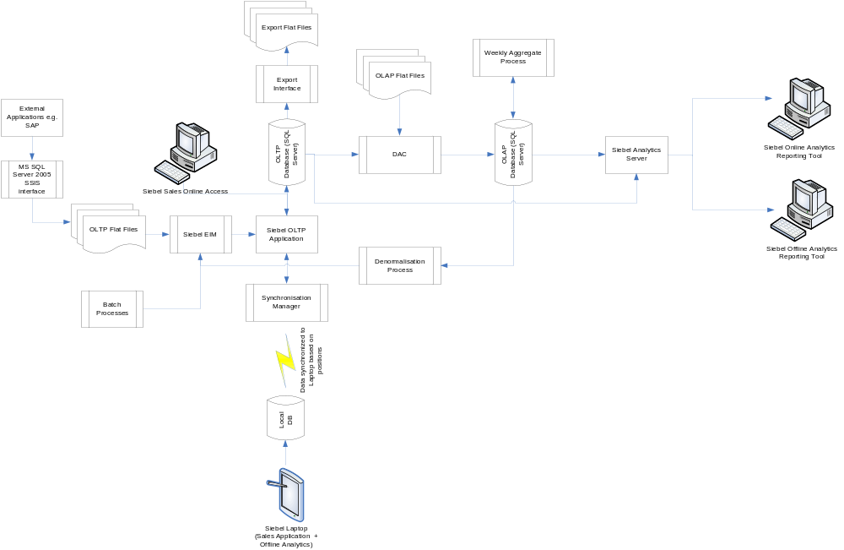

JTI TME Architecture

Slide 14
Estimators & estimation model
Siebel Sales
http://mr2ds0024/JTI/Shared%20Documents/[2]%20PP%20-%20Project%20Planning/10%20-%20JTI%20Estimation%20Model/Sales%20Estimation%20Model/Sales%20Estimator%20v1.0.xls
Siebel Analytics
http://mr2ds0024/JTI/Shared%20Documents/[2]%20PP%20-%20Project%20Planning/10%20-%20JTI%20Estimation%20Model/Analytics%20Estimation%20Model/Analytics%20Estimator%20v1.0.xls
Data & Interface
http://mr2ds0024/JTI/Shared%20Documents/[2]%20PP%20-%20Project%20Planning/10%20-%20JTI%20Estimation%20Model/Data%20Estimation%20Model/Data%20Estimator%20v1.0.xls

Slide 15
Testing & Peer Review Process
Peer Review Process & Templates
http://mr2ds0024/JTI/Shared%20Documents/Forms/AllItems.aspx?RootFolder=%2fJTI%2fShared%20Documents%2f%5b3%5d%20VAL%20%2d%20Validation&FolderCTID=&View=%7b59B097B0%2d8368%2d4A00%2dB31D%2dF80D42D4E1BB%7d
Testing Process & Templates
http://mr2ds0024/JTI/Shared%20Documents/Forms/AllItems.aspx?RootFolder=%2fJTI%2fShared%20Documents%2f%5b3%5d%20VER%20%2d%20Verification&FolderCTID=&View=%7b59B097B0%2d8368%2d4A00%2dB31D%2dF80D42D4E1BB%7d

Slide 16
Technical Documentation
Data Operations
svn://10.186.26.13:443/Phase II/TME_Phase_2_AM/01_Documentation/Batch run process
svn://10.186.26.13:443/Phase II/TME_Phase_2_AM/01_Documentation/Daily Data Load
Technical Architecture
svn://10.186.26.13:443/Phase II/TA
Siebel Sales
svn://10.186.26.13:443/Phase II/OLTP/03 – Documentation
Data & Interface
svn://10.186.26.13:443/Phase II/EIM/07 – Interface
svn://10.186.26.13:443/Phase II/ETL/03 – Documents
Siebel Analytics
svn://10.186.26.13:443/Phase II/Analytics/05. Designs

Slide 17
File Storage Location
Project Portal
\\mr2ds0024\jti
Shared Drive
\\10.186.21.40\jti$
SVN
svn://10.186.26.11:443/
svn://10.186.26.13:443/
More information is available in the Configuration Management Plan.

Slide 18
EPM tool
More information to be made available soon

Slide 19


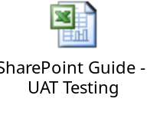
JTI Incident Management Tool
HPSD – track issues and requests for live market
SharePoint – track issues and requests for deployment markets and UAT

Slide 20
Connectivity to JTI Network
File Transfer – FTP server
  External Address: 57.66.69.202 (Accessed through Win SCP)
  Internal Address: 10.64.253.101 (Accessed through Internet Explorer)
VPN Connection
  Connection to Geneva or Singapore gateway made via iPassConnect application
Remote Desktop Connection
  Two servers are available for use by Accenture resource namely:-
  swigva01-srv-56 [10.69.48.87]
  swigva01-srv-57 [10.68.48.194]
Important Note: No direct connection to any JTI resource (web server, database server, any other applications, etc…) should be made directly from the Accenture local machine. Access should only be made from the two dedicated servers for use as mentioned above.

Slide 21
Capability
JTI project forms part of the Siebel Sub Capability and Oracle Capability
Activities performed under capability development are as follows:-
  Consolidation of Assets
  Skill Assessment (CAMS tool)
  Training
  Certification
  Community Meeting
  Response to RFP and other marketing activities

